Slide 1
Migrating TO GIT from SVN
By
Kalpana Uppara

Slide 2
Agenda
Introduction – What is VCS?
History.
GIT vs SVN
Git Branching Strategy.
Git and SVN Basic Commands.
Migrating from SVN to Git
Demo
Conclusion
Q&A

Slide 3


What is VCS?
Apache Subversion(often abbreviated SVN, after its command name svn) is a software versioning and revision control system distributed as open source under the Apache License. Software developers use Subversion to maintain current and historical versions of files such as source code, webpages, and documentation.
Version Control System (VCS) is a software that helps software developers to work together and maintain a complete history of their work.
Following are the goals of a Version Control System.
Allow developers to work simultaneously.
Do not overwrite each other’s changes.
Maintain history of every version of everything.
Git, is a free and open source distributed version control system designed to handle everything from small to very large projects with speed and efficiency.

Slide 4
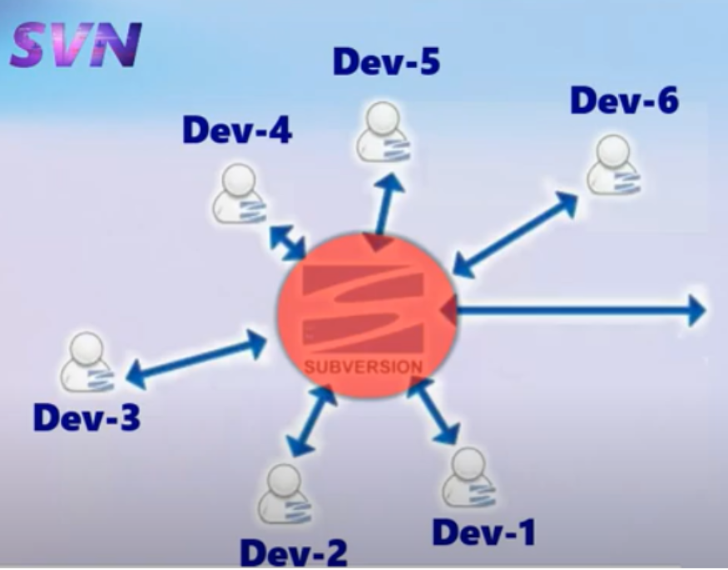
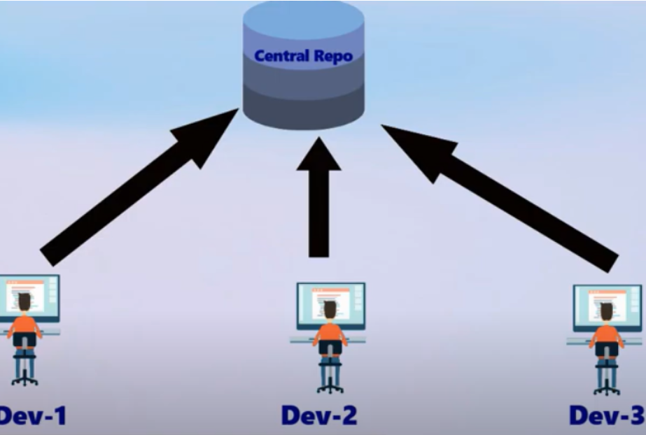
GIT
SVN

Slide 5
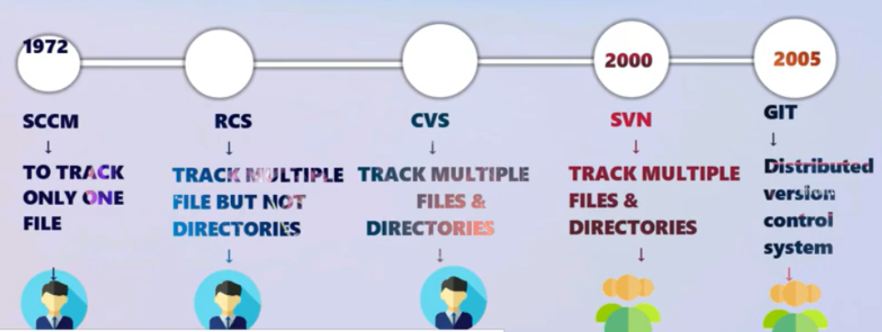
HISTORY

Slide 6
SVN Vs GIT
SVN
GIT
Server – Client Based
SVN always need internet connection.
SVN tracks files.
Svn commit uses revision numbers.
More Diskspace and Low performance.
Centralised Version Control System.
Back-up need to take on server.
Very Hard to find errors in SVN.
Every Project is independent.
Git wants internet when we move to central repo.
Git tracks content.
Git commit uses hashes.
Less Diskspace and High Performance.
Distributed Version Control System.
Back-up can take by any client System.
Very easy to find errors in GIT.

Slide 7
continues…
SVN
GIT
It is revision control.
It has an internationalized revision number.
SVN does not contain any cryptographically hashed contents..
SVN stores content as files.
SVN's content is less secure than Git.
Git is an SCM (source code management).
It does not have a Global revision number.
It has cryptographically hashed contents that protect the contents from repository corruption taking place due to network issues or disk failures.
Git stored content as metadata

Slide 8
Branching strategy:

Slide 10
GIT Features

Slide 11
Basic Commands for both SVN and GIT
Checkout : svn checkout <path-to-repo>
Commit : svn commit
Switching branch/tag: svn switch <target>
New branch/ tag : svn copy <target> <destination>
Merge: svn merge <target>
Commit history : svn log <target>
Checkout : git clone <path-to-repo>
Commit : git commit
Switching branch/tag: git checkout <target>
New branch/ tag : git branch –b <Newbranchname>
Merge: git merge <target>
Create tag: git tag –a <tag-name>
Push to remote(when done): git push
View history : git log

Slide 12
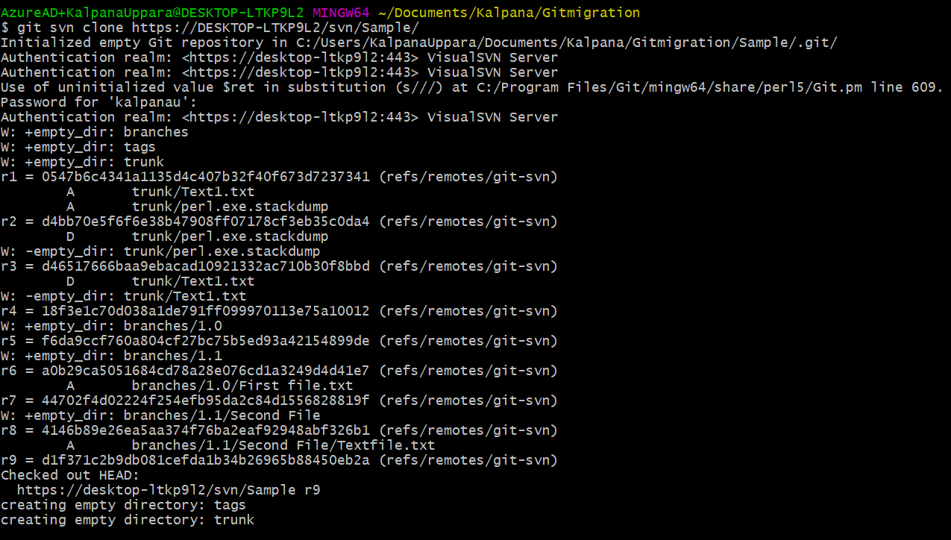
Get you Sample SVN PROJECT!

Slide 13
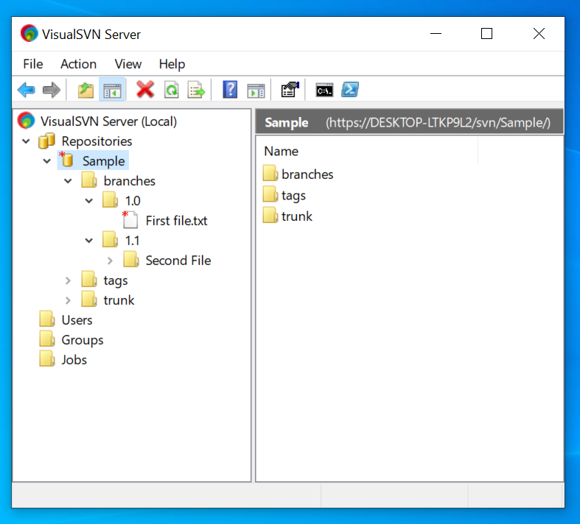
Visual SVN

Slide 14
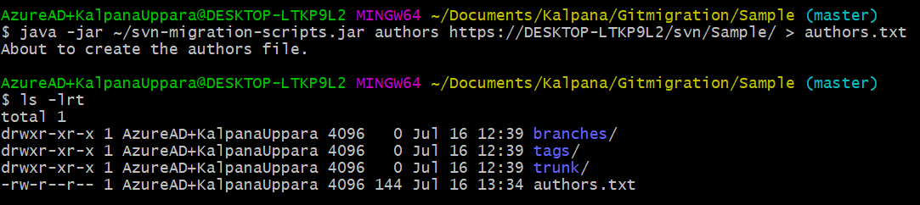
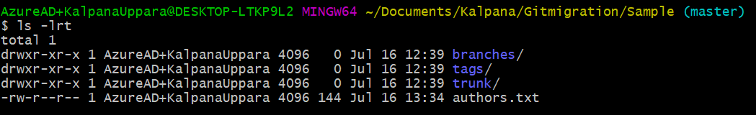
Authors.txt

Slide 15
PUSH to YOUR Git REPOSITORY

Slide 16
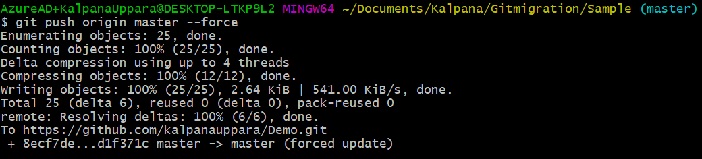

Slide 17
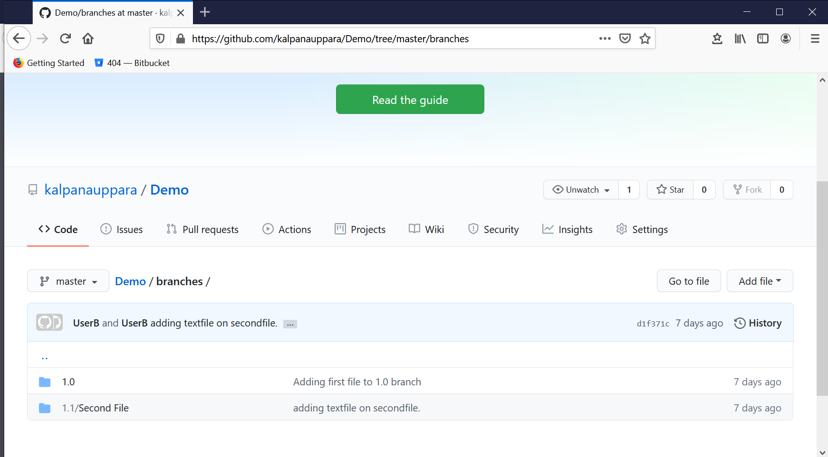
Git Hub with SVN PROJECT!!!

Slide 18
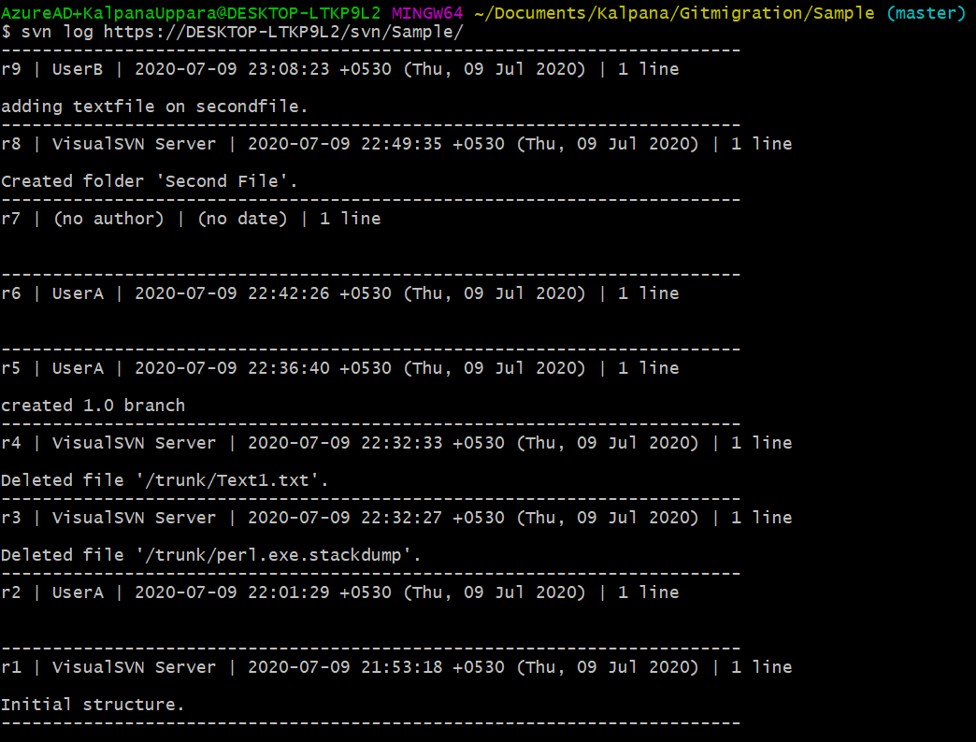
Checking LOGS:

Slide 19
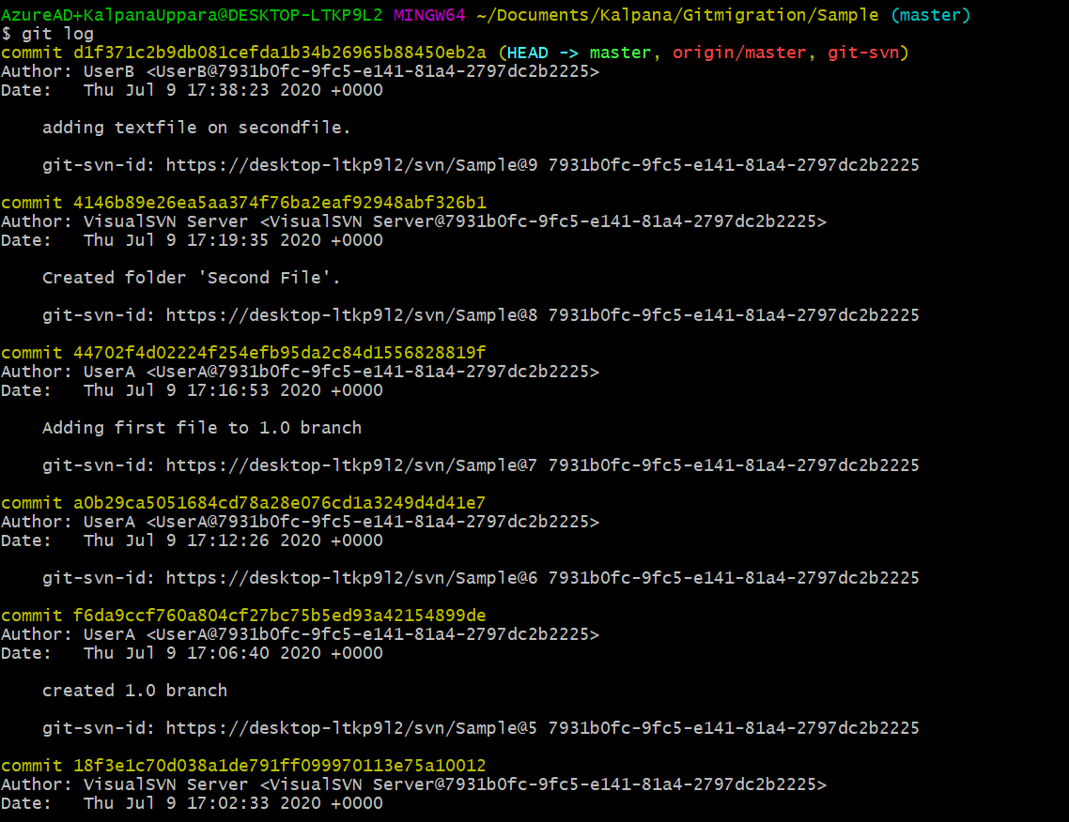

Slide 20
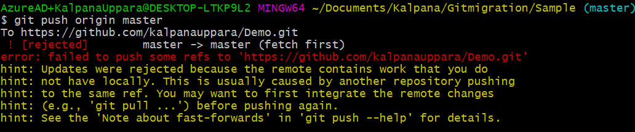
ISSUES FACED:

Slide 21
References:
https://www.atlassian.com/git/tutorials/migrating-convert

